Slide 1


Text-Based Patient-Nurse Communication System
This presentation introduces a groundbreaking text-based patient-nurse communication system powered by Gemini AI, a cutting-edge platform for natural language understanding and response. This system aims to enhance patient care and streamline communication within healthcare environments.

Slide 2
Introducing Gemini AI: The Intelligent Assistant
Natural Language Processing (NLP)
Speech Services
Gemini AI leverages NLP capabilities to comprehend patient requests and inquiries, ensuring accurate and timely responses.
The system incorporates speech-to-text and text-to-speech features, enabling patients who are unable to type to communicate effortlessly.

Slide 3

Seamless Patient Interaction through Natural Language
Intuitive Interface
Personalized Communication
Patients can express their needs and concerns using natural language, creating a user-friendly experience.
The system adapts to each patient's communication style, promoting a personalized and engaging interaction.

Slide 4

Projected Outcomes and Impact
1
Improved Response Time
2
Enhanced Communication
Faster response to urgent needs.
Clearer and more consistent communication.
3
Reduced Workload
Nurses can focus on patient care.

Slide 5

Leveraging NLP and Speech Services for Understanding
Text Analysis
Speech Recognition
Contextual Awareness
Advanced NLP algorithms dissect text to identify key requests and sentiments, ensuring comprehensive understanding.
Speech-to-text technology converts spoken requests into written format, facilitating seamless communication for diverse patients.
The system leverages patient history and previous interactions to provide relevant and tailored responses.

Slide 6
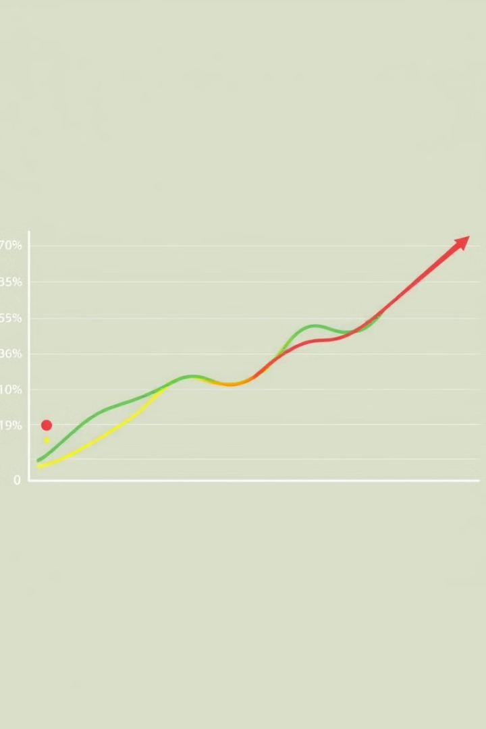



Prioritizing Requests Based on Urgency
Emergency
Urgent
Critical requests, such as pain or breathing difficulties, are automatically prioritized for immediate attention.
Requests requiring prompt attention, like medication reminders or questions, are prioritized within a designated timeframe.
Routine
General inquiries and non-urgent requests are processed in a timely manner based on their relative importance.

Slide 7

Delivering Patient Requests to Nurses via Mobile App
1
2
3
Patient requests are categorized based on urgency and content.
Nurses receive relevant requests directly on their mobile app, eliminating delays and ensuring responsiveness.
The app prioritizes requests based on urgency, ensuring nurses focus on the most critical needs first.

Slide 8

React Native/Expo frontend, Node.js/MongoDB backend
1
Frontend
React Native/Expo for a cross-platform mobile app.
2
Backend
Node.js and MongoDB for efficient data management.

Slide 9
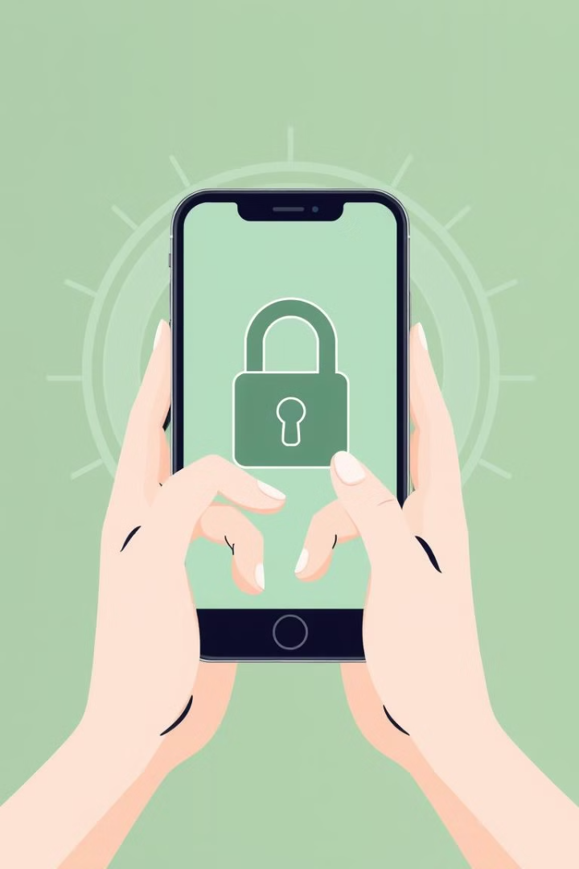



Secure Patient Registration and Nurse Approval Process
Patients can register directly through the system, providing basic information and contact details.
Nurses require admin approval for access, ensuring a secure and controlled environment for patient data.
The system utilizes robust security measures to protect patient privacy and ensure data integrity.

Slide 10



Robust React Native/Expo Frontend, Node.js/MongoDB Backend
Frontend
1
Built with React Native and Expo, the frontend offers a smooth and responsive user experience for both patients and nurses.
Backend
2
Powered by Node.js and MongoDB, the backend ensures secure data storage, processing, and delivery.
Scalability
3
The system is designed to scale with the growing needs of healthcare organizations, accommodating increased user activity and data volume.

Slide 11



The Future of AI in Healthcare Communication
1
Personalized Care
2
Proactive Monitoring
3
Predictive Analytics

Slide 12


Call to Action: Partnering for Better Healthcare
Collaboration
Join us to build a more efficient and effective healthcare system.

Slide 13
Improving Workflow Efficiency and Patient Satisfaction
Reduced Communication Gaps
1
The system streamlines communication, minimizing delays and ensuring timely responses to patient requests.
Enhanced Patient Care
2
By improving communication and responsiveness, the system fosters a more patient-centered approach to care.
Increased Nurse Satisfaction
3
The system simplifies workflow for nurses, reducing stress and enabling them to focus on providing high-quality care.

Slide 14




AI-Powered Insights: Understanding Patient Needs
Request Analysis
Natural Language Processing (NLP) interprets patient requests.
Urgency Determination
AI prioritizes requests based on urgency.
Insights Generation
AI provides insights into common patient needs.

Slide 15
AI-Driven Communication: Transforming Patient Care
Text-Based Communication
1
Patients use a text assistant for direct communication.
Automated Delivery
2
AI agents deliver prioritized requests to nurses.
Real-Time Updates
3
Nurses receive updates and respond via mobile app.

Slide 16

Project Overview: Enhancing Patient Care with Technology
This project creates a text-based patient-nurse communication system using Gemini AI. Patients use a text assistant for natural communication, while autonomous AI agents analyze requests using NLP and Speech Services (text-to-speech, speech-to-text). The system prioritizes requests based on urgency and delivers them, including room and content, to nurses via a mobile app (React Native/Expo frontend, Node.js/MongoDB backend). Patient registration is direct, but nurses require admin approval. The project leverages cutting-edge AI technology to create a seamless and efficient communication channel between patients and nurses, leading to improved patient care and satisfaction.

Slide 17

Conclusion and Future Developments
1
2
Empowering Patients
Streamlining Communication
The system empowers patients to communicate their needs effectively, fostering a sense of agency and control.
The system streamlines communication between patients and nurses, creating a more efficient and responsive healthcare environment.
3
Future Innovations
Future developments include integrating additional AI-powered features, such as personalized care plans and predictive analytics, to further enhance patient care.

